Slide 1
ECE324 Final Project
Predicting Restaurant Ratings from Images obtained from Yelp Dataset
Hshmat Sahak, Grant Lau, Vince Tran

Slide 2
Project Overview and Motivation
Predicting Yelp restaurant ratings using images from customer reviews.
Allows images to become an additional source of information to determine restaurant rating.
Interested in comparing accuracy of image models to text models.
Useful for social media platforms with image data to create travel guide/business recommendation features.
Notes:
Vision-based Real Estate Price Estimation

Slide 3
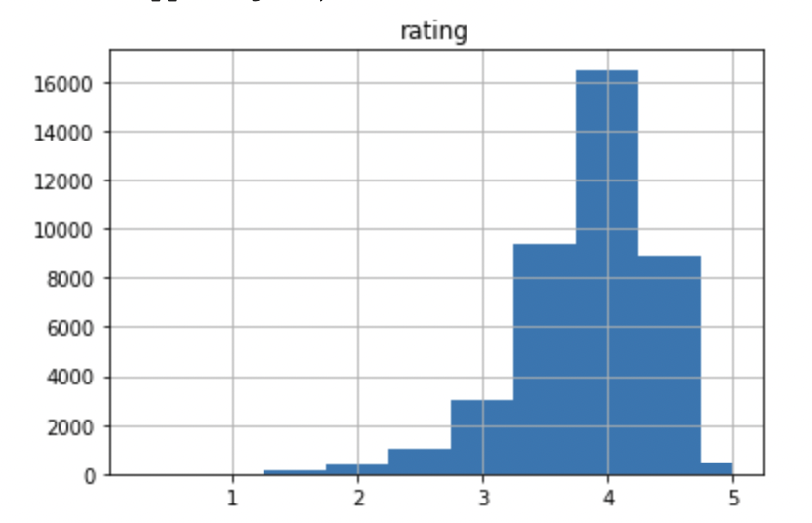
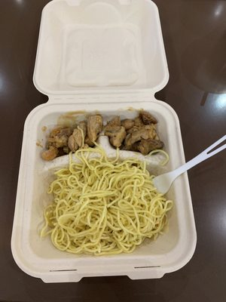
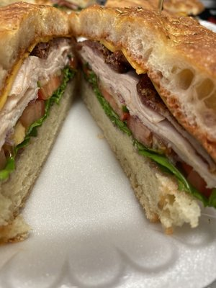
Data Collection Process
Began with 40,000 photos tagged as “food” from the Yelp Images Dataset. Each image comes with an associated Yelp Business ID.
Made calls to the Yelp API to retrieve the restaurant rating and up to 3 truncated reviews (and the review specific rating) for each Business ID.
Currently web scraping using Beautiful Soup to retrieve full reviews for each Business ID.
Figure 1: Rating Distribution for restaurants in Yelp Image Dataset
1.5 star rating
5.0 star rating

Slide 4
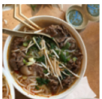
Using a CNN for Image → Rating Prediction
weight sharing feature
reduces the number of trainable network parameters, in turn helping the network to enhance generalization and to avoid overfitting
translation-invariance through the sliding filters
generalization through max pooling layers
We expect that layers at the beginning are responsible for detecting low-level features such as edges and colors and the layers at the end are responsible for detecting high-level features such as foods that directly help with the regression task.
CNN
5-Star Rating
Figure 2: CNN approach from image to rating

Slide 5
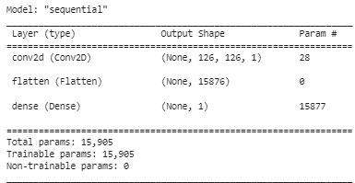
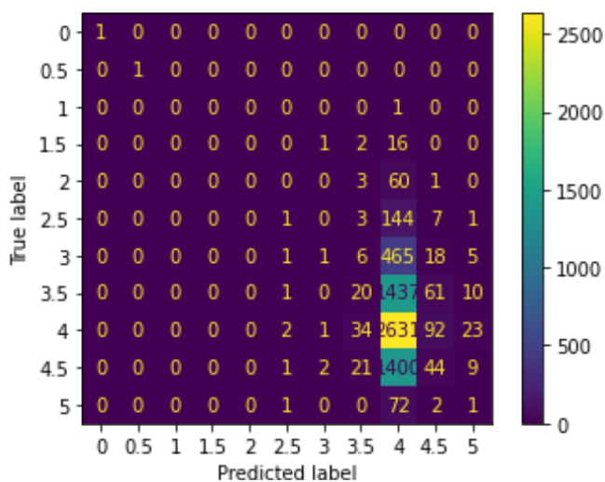
Basic CNN Model
Before progressing to more complex architectures motivated by literature (e.g., pretrained networks, ensemble method), we first trained a very basic CNN to use as a baseline when assessing performance of future networks. This CNN had only one convolution layer, with filter size (3,3) and ReLu activation function. This layer was then flattened and connected to a dense layer with one output that attempts to predict the final rating.
Figure 3: Model Summary for Simple CNN
Results:
MSE on Train Set: 0.3086
MSE on Test Set: 0.3249
Figure 4: Simple CNN Results
Figure 5: Confusion Matrix for Model 0, trained on 20,000 images

Slide 6
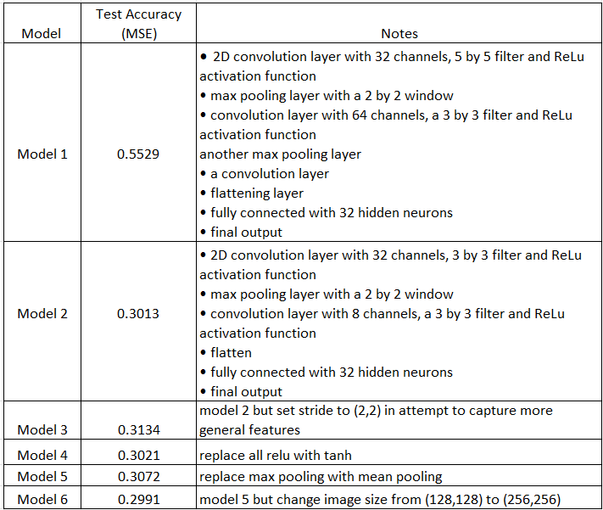
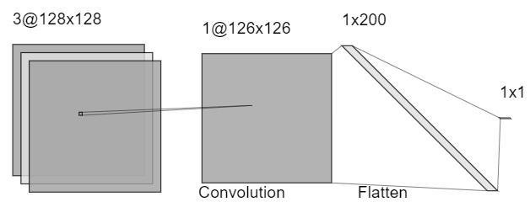
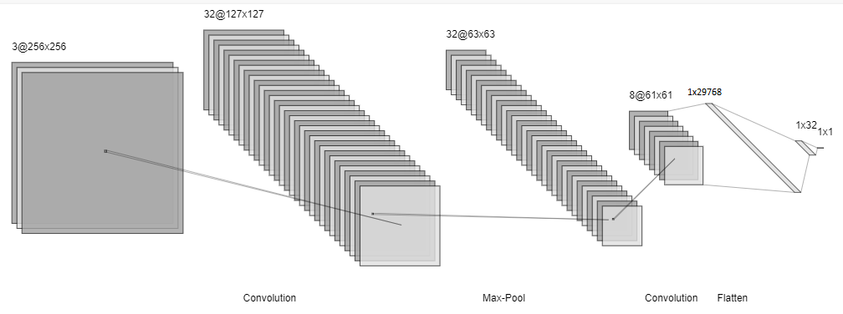
More Complex CNN Models
Figure 6: Simple CNN Architecture Diagram
Table 1: Hyperparameter tuning summary
Figure 7: Model 6 Architecture Diagram

Slide 7
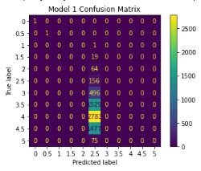
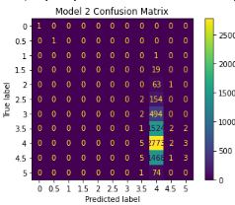
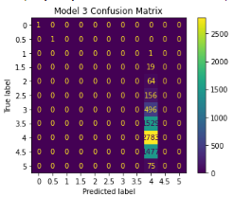
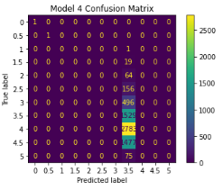
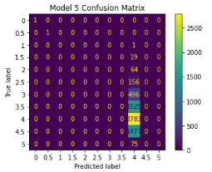
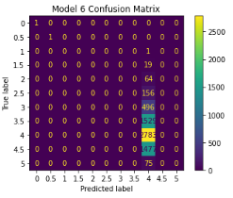
Qualitative Observations
Figure 8: Model 1 Confusion Matrix
Figure 9: Model 2 Confusion Matrix
Figure 10: Model 3 Confusion Matrix
Figure 11: Model 4 Confusion Matrix
Figure 12: Model 5 Confusion Matrix
Figure 13: Model 6 Confusion Matrix

Slide 8
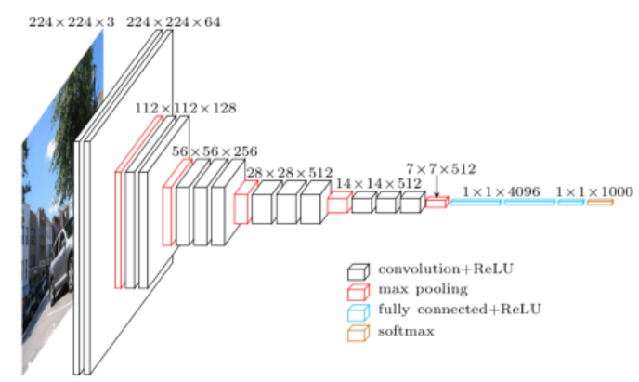
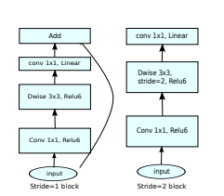
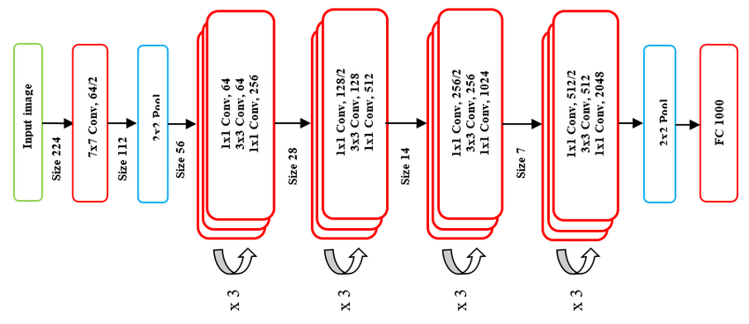
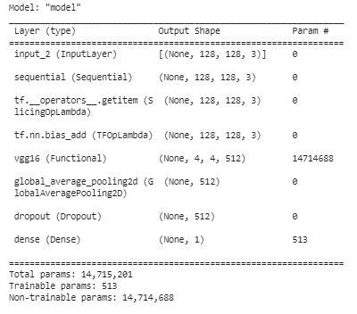
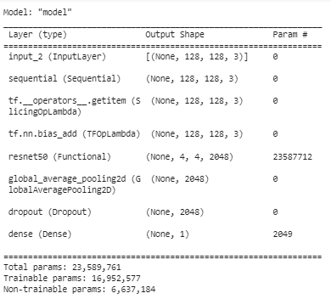
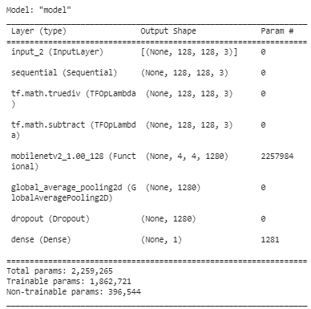
Alternative: Exploring Pretrained Networks as Feature Extractors
ResNet50
Figure 14: VGG16 fine tuned
Figure 15: ResNet50 fine tuned
Figure 16: ResNet50 fine tuned

Slide 9
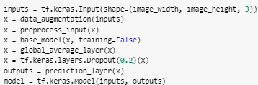
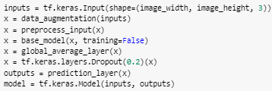
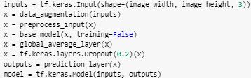
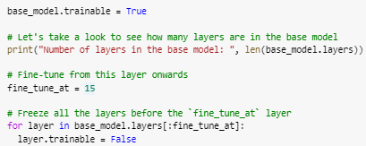
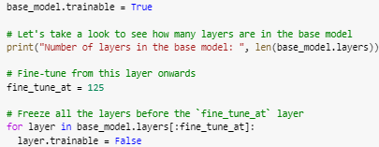
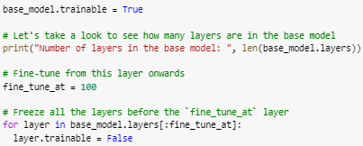
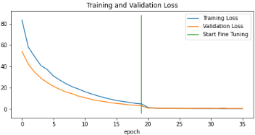
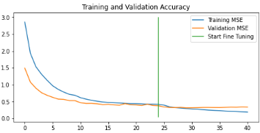
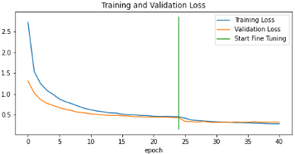
Results
VGG16 Pre-trained model + Classification Head
ResNet50 Pre-trained model + Classification Head
MobileNetv2 model + Classification Head
Fine-tuning
Fine-tuning
Fine-tuning
Test MSE: 0.4964
Test MSE: 0.3349
Test MSE: 0.3075

Slide 10
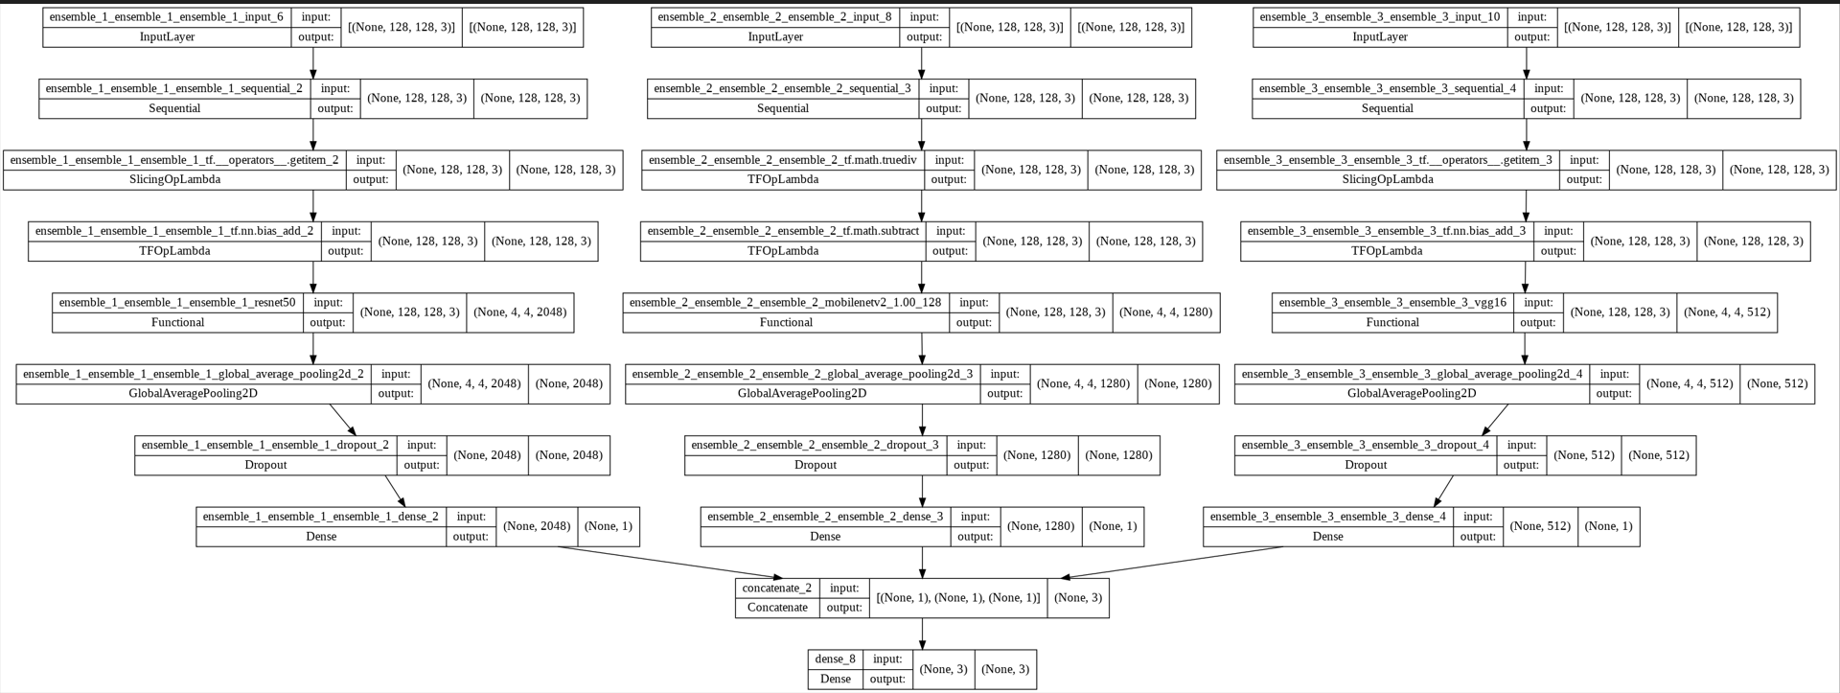
Ensemble Architecture
Figure 17: Ensemble of CNNs approach

Slide 11
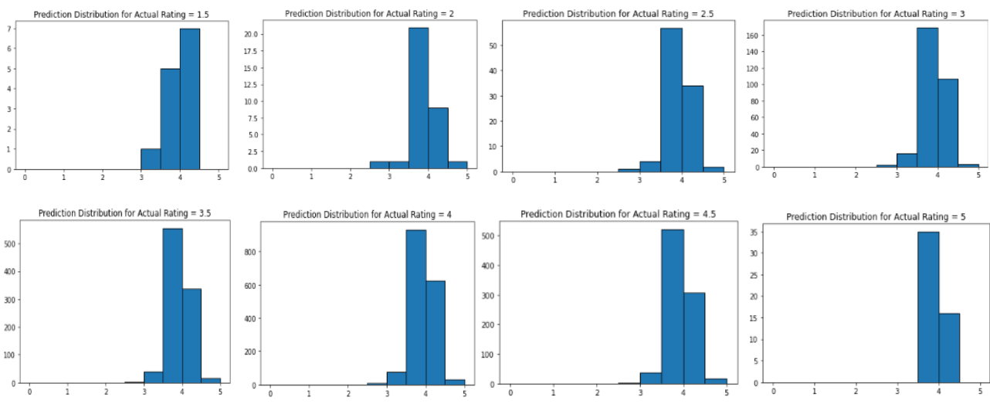
Ensemble Approach Results
Test MSE: 0.30845221877098083
Figure 18: Prediction Distributions For Various True Ratings

Slide 12
How can we do better?

Slide 13
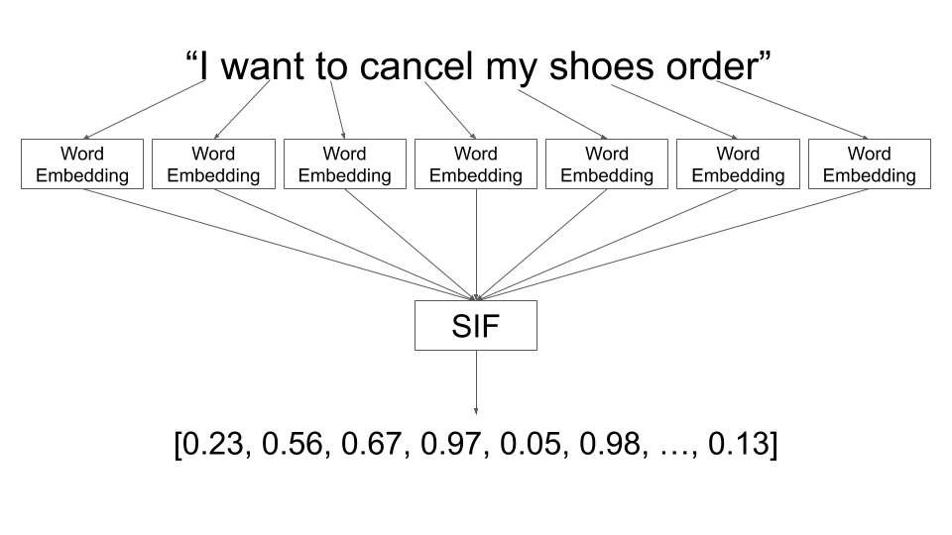
Figure 20: Demonstrating word embedding example

Slide 14
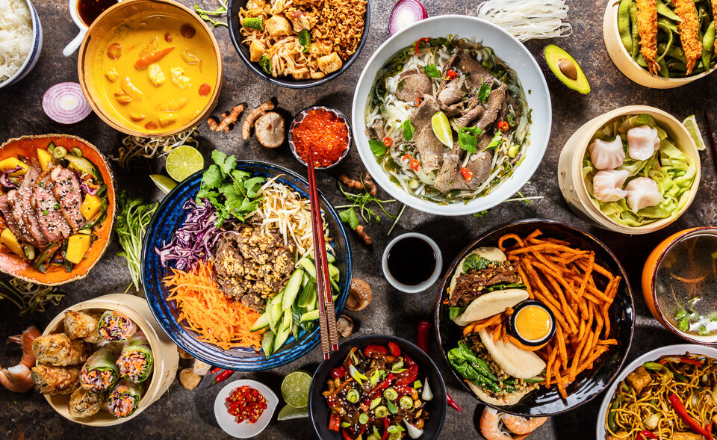
Figure 21: Demonstrating image to embedding example

Slide 15
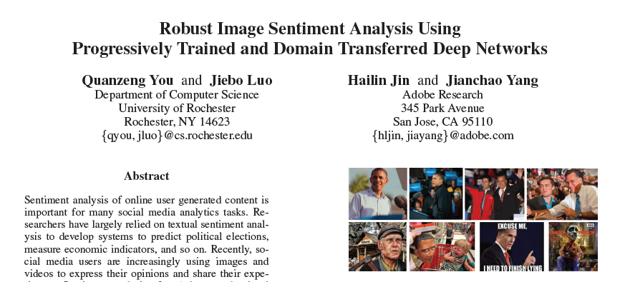
Figure 19: Background Research

Slide 16
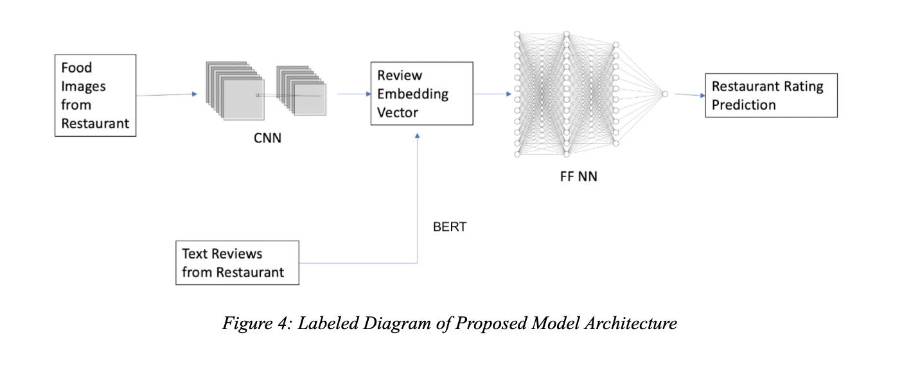
VGHNet

Slide 17
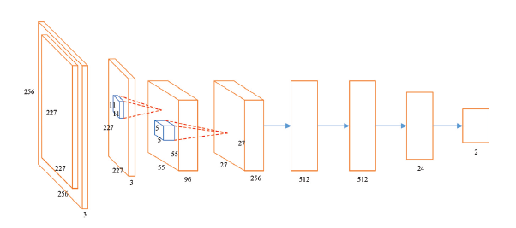
Figure 22: CNN Half of VGHNet (from Adobe paper)

Slide 18
70%
0.90
Predictions within 1 star*
MSE Loss

Slide 19
Next steps
Continue to train VGHNet. Train on larger dataset, perform hyperparameter tuning.
Balance the dataset. Scrape additional images from restaurants with very low and very high ratings.
Adjust Loss function. Penalize predictions that are far away from extreme ratings more heavily.
Finish downloading long reviews
Test custom embeddings.

Slide 20
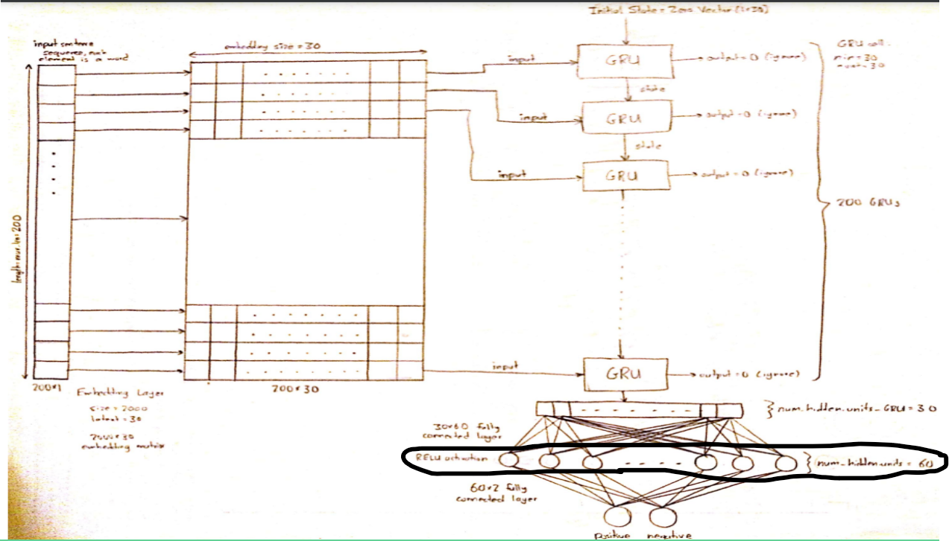
Figure 23: Network for Custom Embeddings

Slide 21
